Slide 1
Module 1:
Overview
Foundations of ML for Security
ML for Cybersecurity
November 10, 2020

Slide 2
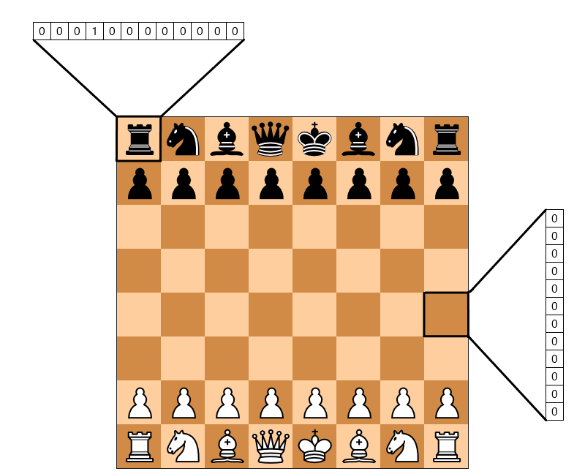



What is Machine Learning?
Automatic discovery of predictive rules from history

Slide 3
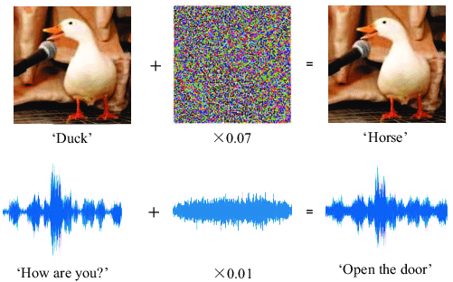

Machine Learning as a Tool for Cyber Security
Attacks – Learning – Defense
Machine learning for security
Security against attacks that exploit machine learning
Notes:
What’s the impact of ML on cybersecurity

Slide 4
Machine Learning Use Cases
For every file sent through the network, does it contain malware?
For every login attempt, has someone’s password been compromised?
For every email received, is it a phishing attempt?
For every request to your servers, is it a denial-of-service (DoS) attack?

Slide 5

Definition of Machine learning
Arthur Samuel, 1952:
Machine learning is the ability to learn without being explicitly programmed

Slide 6
A Brief History
1950: Alan Turing created the world-famous Turing Test — “The Imitation Game”
1952: Arthur Samuel coined the phrase “machine learning”, and create a computer program that improves checkers game
1956: The Dartmouth workshop started AI as a field (John McCarthy, Marvin Minsky, Nathaniel Rochester, Claude Shannon …)
1958: Frank Rosenblatt designed the first artificial neural network
1986: Geoffrey Hinton introduced backpropagation which enabled monumental leaps in ANNs
1995: Cortes and Vapnik “standardized” support vector machines
1997: Deep Blue beats a chess champion
1999: Computer-aided diagnosis catches more cancers (CAD Prototype at UChicago)
2009: Launch of ImageNet
2011: Watson competed on Jeopardy! and won against Ken Jennings and Brad Rutter
2012: AlexNet won the ImageNet competition, which led to the use of GPUs and Convolutional Neural Networks in machine learning
2016: AlphaGo defeated the human champion Lee Sedol in a best-of-five duel match
…
Now: AI dominates Silicon Valley and becomes pervasive
https://cloud.withgoogle.com/build/data-analytics/explore-history-machine-learning/
Notes:
Role of cybersecurity (adding one or two bullet points to the history)

Slide 7
Related disciplines
information theory
statistics
philosophy
causality
Machine Learning
algorithms
optimization
neural-informatics
Notes:
Adding a slide: Applications /industrial domains
Domains:
Cybersecurity
Industrial Players
News articles;

Slide 8
Module Overview

Slide 9
Machine Learning for Cyber Security
Module 1: “Statistical Modeling”
Module 2: “Data Representation”
Foundations of ML and Data Science for Cybersecurity
Data-Driven Network and
Computer Security
Module 3: “Learning Scenarios”
Module 4: “Practical Aspects”
Machine Learning in the Presence of Adversaries
Ethics, Fairness, Responsibility,
and Transparency in
Data-Driven Cybersecurity
Notes:
A module focused on machine learning fundamentals, with applications to security. Introduction to the data science pipeline, and teach fundamental building blocks, from data ingestion and feature engineering to machine learning model selection.
Modeling; Representation; Environment; Constraints (?)

Slide 10

Foundations of “Modeling”
Machine learning pipeline
The statistical learning framework
Generative & discriminative modeling
Basic supervised learning models
Logistic regression
Naïve Bayes
Neural nets
Unsupervised learning
Dimensionality reduction
Clustering
Credit @NOELIAGOROD
Notes:
CNN
Application in Cybersecurity (as running, concrete examples)
Coloring, animation, highlighting (hand drawing)

Slide 11
Learning Objective

Slide 12
After participating in this module, you will
understand basic machine learning ideas & concepts
learn to use statistical tools to analyze machine learning models
understanding the role of ML in data-driven cybersecurity
have some experience applying machine learning algorithms on cybersecurity applications
Notes:
Measurable outcomes
Actionable
----
Some recommendations around reframing the learning objectives as measurable outcomes:
a. Describe the basic ideas and concepts underlying the practice of machine learning
b. Identify where and how machine learning can play a key role in cybersecurity
c. Analyze machine-learning models using statistical tools and choose the best model for a use case
d. Implement for cybersecurity applications a variety of machine learning models, from classical models such as logistic regression to deep learning techniques such as convolutional neural networks

Slide 13
Rest of this module
ML Basics
Supervised learning
Neural networks and deep learning
Unsupervised learning
A primer to ML in python
Notes:
Might consider reiterating here how the videos, notebooks, and live sessions fit together in the module
1. Order? Watching all the videos, then doing the notebooks? Or doing them in the order provided?
2. How to use notebooks? Just read through them? Encourage them to experiment, etc.?

